Slide 1
Water Resource Management
Group :10th
^{Aanand 18114001}
^{Pramod 18114055}
^{Subhash 18114076}
^{Anupam 18114009}
^{Ravindra 18114064}

Slide 2
Problem Statement
The municipal corporation once sat and planned to manage the water resource in their city . After 17 days of rigorous discussion they concluded that if residents are made to save the water it will create havoc ,thus they decided to create ,manage and monitor a web portal for water supply and management which must be accessible to the residents of the city . All the residents have to register in the application ,the family members must be registered as single account with details of them . If the resident (family) is a new user he(they) must register into web portal by filling the details such as name(s), address, phone number(s), email(s) etc. Otherwise he/she could simply login into the webportal by using username and password. Once logged in ,the user must be able to see his (their) details and should be able to to update them with time as needed. Every (user)family has to register for water supply by filling start date and end date according to his/her requirements. The program ie the web portal should log the amount of water consumed by family over last one month on daily basis. When the daily consumption crosses the daily average ( monthly water amount registered by user / days in the respective month) the system should mail the resident an auto-system-generated mail regarding the same. If the user(s) has(have) any complaint(s) regarding the water supply he can log the complaint using the webportal. The employee for this portal views the complaints and forwards them. When they start resolving the problem they (ie employee) sends the user notice(s) regarding the same giving him the details that they are working on the complaint submitted by user. The residents can see their bills in the web portal run by municipal corporation. They can pay their bills accordingly. The municipal corporation finally decided to give the project to your team .Hence create the application for helping the city to manage their water resource

Slide 3

USE CASE VIEW
Profile
Cost
SEE
Existing Family
Login
UPDATE/SEE
CHECK
Record
SEND
Mail
Resident
Home
REQUEST
Complaints
SEE
CHECK
UPDATE
Employee
New Family
New Registration
Status
Payments
Bank

Slide 4
Registers
*
1
Part of
*
Family
Resident
*
Applicant can see status
-member:vector<Residents>
-address:String
-FamilyID:int
-counter :int =1
-day: int = 0
-RecObj : Records
-password: String
-b: Bill
-com: Complaint
-name:String
-phoneNo:long
-email:String
Complaint
complaintID
1
+count:int = 1
-id:int
-status:String
-compl:String
-solvedORNot:boolean
+setName(in s:String):void
+getNname():String
+setPhoneNo((in p:long):void)
+getPhoneNo:long
+getEmail():String
+setEmail(in e:String):void
+Resident(in n:String,in p:int,in e:String)
+update(in n:String,in p:int,in e:String)
+print():void
See/pay
+Complaint(s:String)
+Update(Status:String,b:boolean):void
+getID():int
+getComplaint():void
+print():void
+getSolvingOrNot():boolean
+Family(in a:String,in n:String,in em :String,in p:String,in phn:long):void
+newResident(name:String,phn:int,email:String):void
+seeRecord(familyID:int):void
+complainAdd(complaint:String):void
+checkComplaint(compID:int):void
+payBill(familyID:int):void
+seeBill(familyID:int):void
+setAddress(add:String):void
+getAddress():String
+setFamilyID(FID:int):void
+getPass():void
+getFamilyID():int
+newResident(in n:String,in phn:long,in em:String):void
+noOfResident():void
+getResidentName(in i:int)
+updateRes(in i:int,in n:String,in p:long,in e:String):void
+passToRecord():void
+newRecord():void
+print():void
*
*
Bill
login
+rate:int = 5
-paid:Boolean = false
+CalculateBill():int
+PayBill():void
+setPaid():void
Can update
1
1
Can see
familyID
1
complaintID
1
1
Employee
Records
familyID
+id:int
-records:ArrayList<ArrayList<Arraylist<int>>>
contain
Portal
+Employee():void
+getID():int
+viewComplaint(in obj:Complaint):void
+updateComplaint(obj:Complaint):void
+addData(in familyID :int,in day:int,int amount:int):void
+printData(in familyID :int):void
+mailSend():void
+getAmount(in familyID:int,in day:int)
Main():void
1
1
login

Slide 5
Registers
*
1
*
Resident
*
Family
1
1
*
Applicant can see status
See/check
Can see
*
*
complaintID
Complaint
login
Bill
Can update
1
1
familyID
familyID
1
complaintID
1
1
Record
Portal
Employee
1
1
login

Slide 6
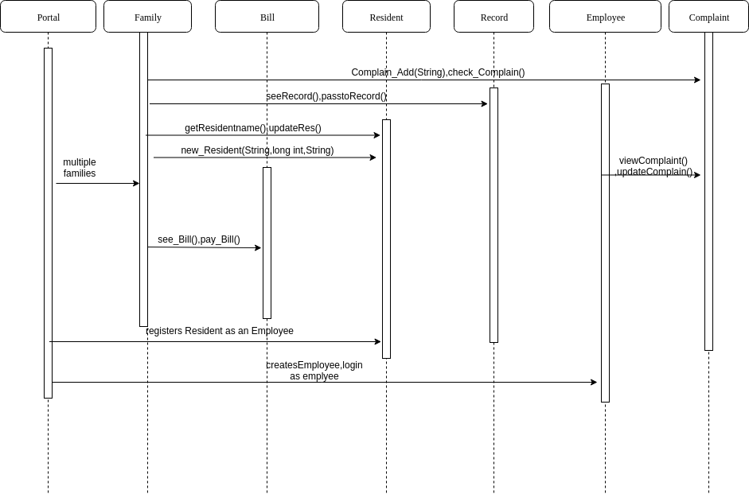

Slide 7
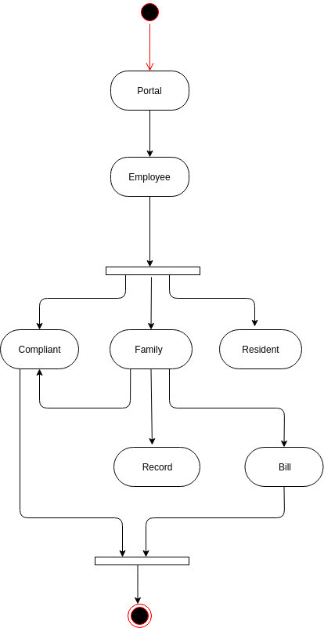
Activity Diagram

